Slide 1
Jose’s Health Data Cavalcade Extravaganza!
With supporting roles from:
Mirana Chavez, Dwight Mauk, Robert Mabry

Slide 2
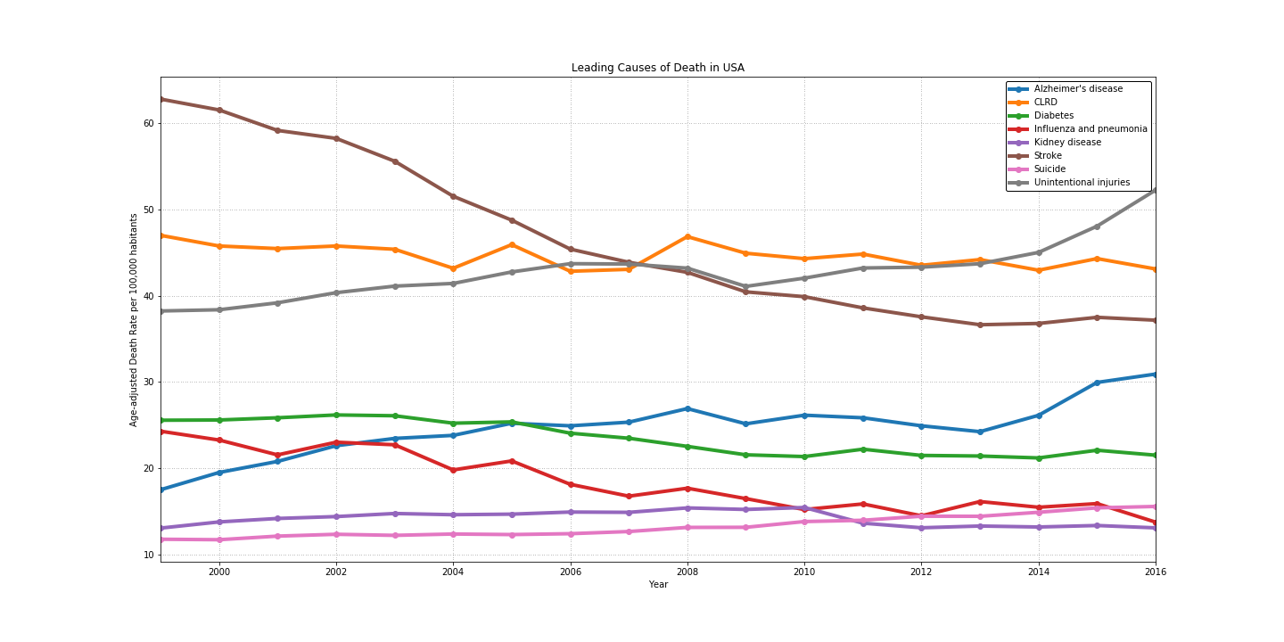
Bottom Causes of Death

Slide 3
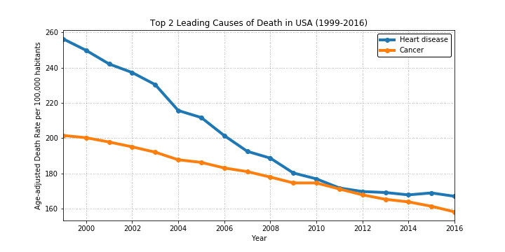
Top 2 Leading Causes of Death

